Slide 1
Multi-Disease Prediction Using Machine Learning Techniques
BY
GIRIJA SWAMINATHAN

Slide 2
Introduction :
Healthcare diagnosis often relies on manual analysis and clinical experience
Early detection of diseases plays a crucial role in improving patient outcomes
Machine Learning enables automated, accurate, and faster disease prediction
This project focuses on predicting Kidney, Liver, and Parkinson’s diseases

Slide 3
Problem Statement :
Traditional diagnostic methods are time-consuming and subjective
Late detection of diseases leads to severe complications
There is a need for an intelligent system that can assist in early disease prediction
Manual interpretation of medical data can lead to errors

Slide 4
Objectives :
To develop a Machine Learning–based system for disease prediction
To predict Kidney, Liver, and Parkinson’s diseases using patient data
To improve early diagnosis and decision support
To provide a user-friendly interface for easy access
Covers prediction of three critical diseases

Slide 5
Dataset Description :
Separate datasets used for Kidney, Liver, and Parkinson’s diseases
Includes numerical and categorical medical parameters
Dataset contains patient records with disease labels

Slide 6
Techniques Used :
Python programming
Data preprocessing
Train-Test split
Model Training
Hyperparameter Tuning
Performance Metrics
Model saving
Streamlit Deployment

Slide 7
PREPROCESSING
Checked Missing values, Nan Values, and Duplicates records
Removed irrelevant and unnecessary columns to enhance data quality & model accuracy
Performed outlier detection using KDE plots and addressed outliers through log transformation
Split the dataset into training and testing sets using a 70 : 30 ratio
Encoded categorical variables using Label Encoding
Standardized numerical features using StandardScaler
Applied SMOTE to handle class imbalance through oversampling
Ensured the dataset was clean, balanced, and well-prepared for model building

Slide 8
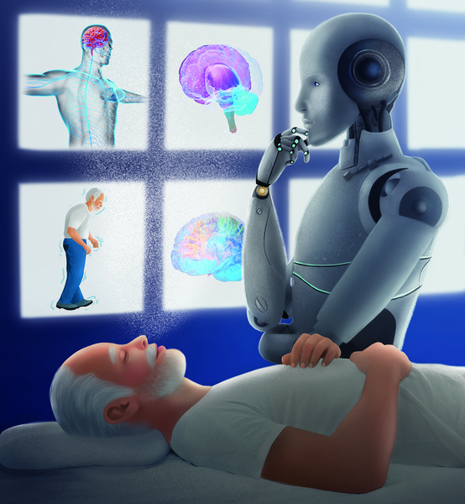
PARKINSONS DISEASE PREDICTION :

Slide 9
Data Cleaning
Data collection
Feature selection
Cleaned Data
X = Features, Y = Target
Train Test Split
Normalization
Ready for model Training

Slide 10
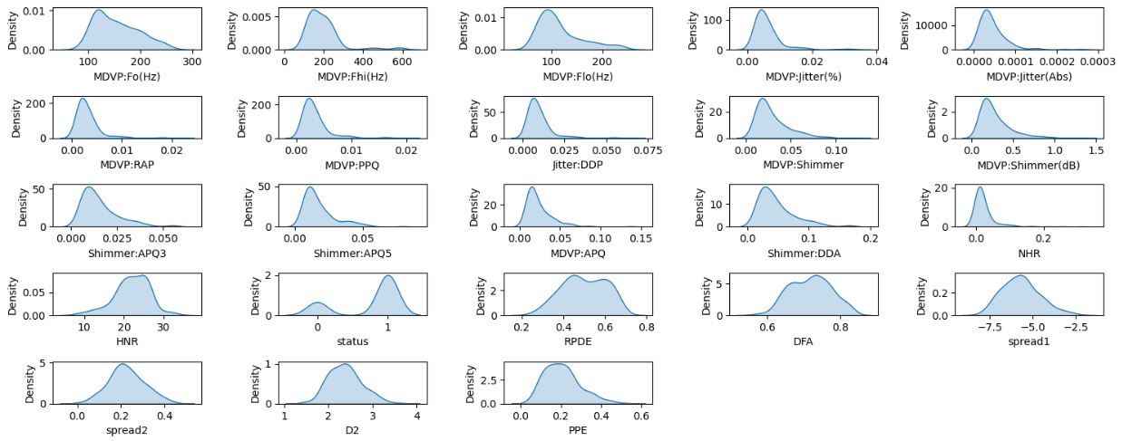
Features distribution :

Slide 11
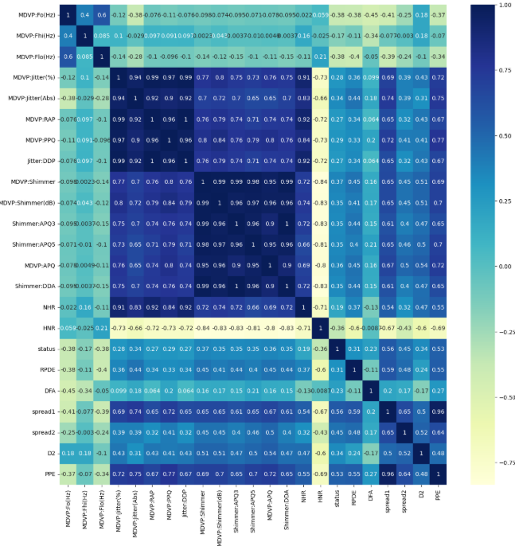
Correlation :

Slide 12
Models
Logistic Regression
ACCURACY : 91%
Precision – 90%
Recall – 97%
F1_score – 94%
AUC_ROC – 91%
GBC
ACCURACY : 90%
Precision – 90%
Recall – 90%
F1_score –89%
AUC_ROC – 96%
XGBC
ACCURACY : 94%
Precision – 94%
Recall – 100%
F1_score – 94%
AUC_ROC – 96%
Random Forest
ACCURACY : 94%
Precision – 92%
Recall – 94%
F1_score –94%
AUC_ROC – 94%

Slide 13
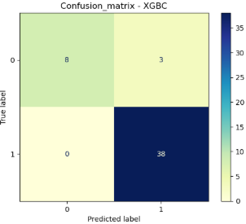
Confusion Matrix :
Model correctly predicted 38 PD cases
Correctly identified 8 healthy individual
3 healthy individuals were incorrectly predicted as PD
No PD cases were missed

Slide 14
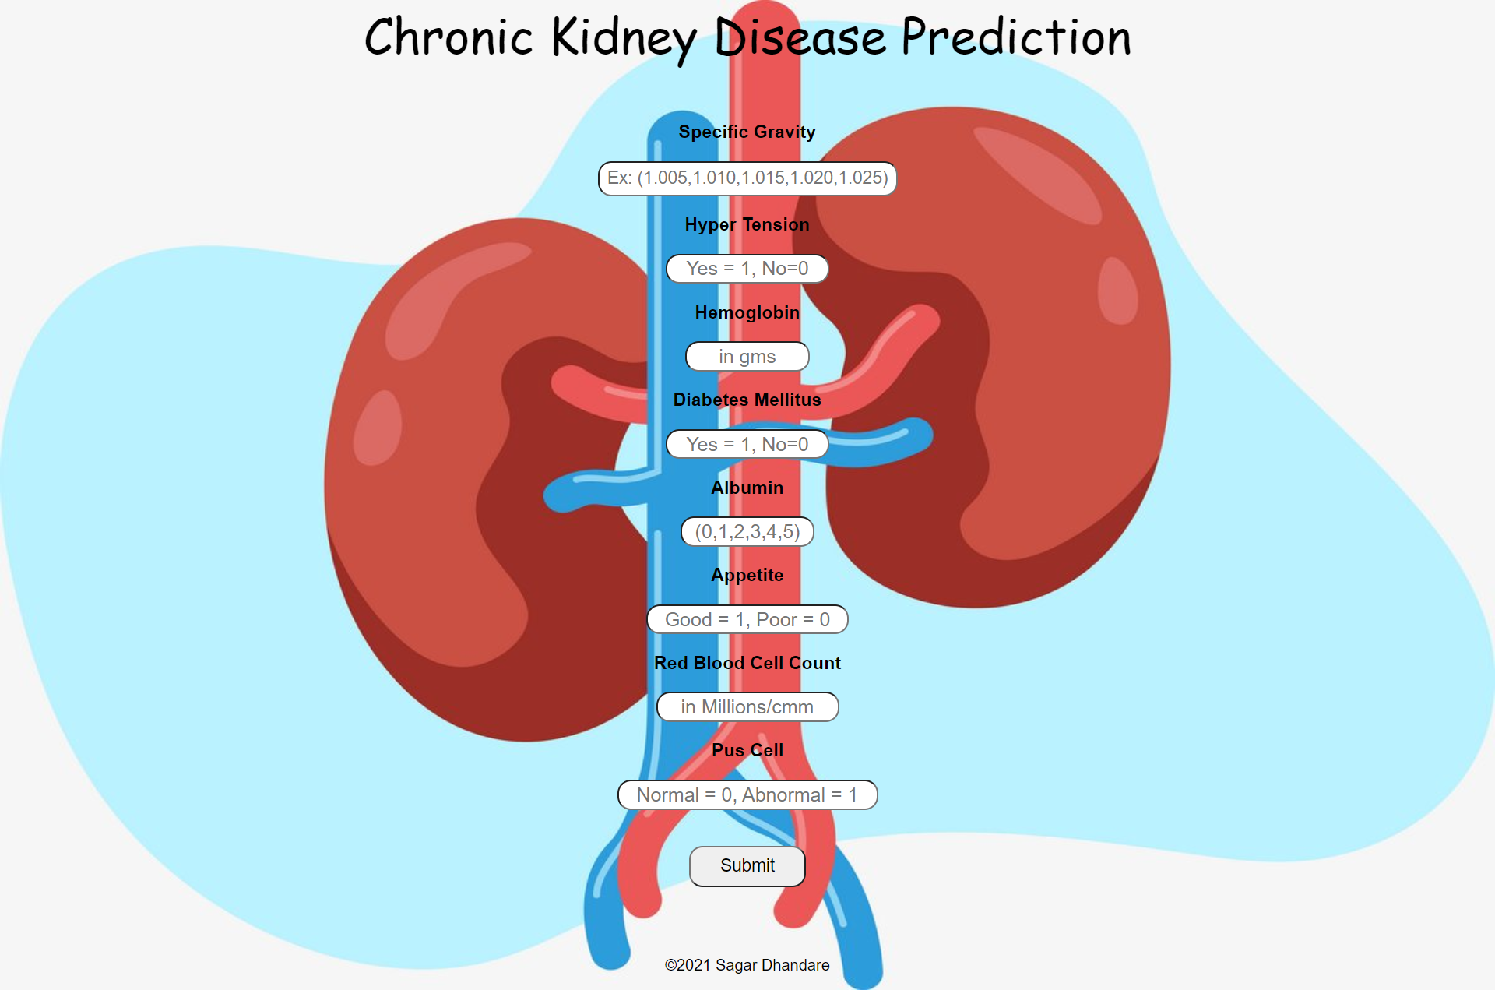
KIDNEY DISEASE PREDICTION :

Slide 15
Preprocessing
Data load
Log Transformation
Features & Target
Train Test Split (70:30)
Models
Logistic Regression
Data type change
Treating nan(Median Imputation)
Encoding
Normalization
Feature Importance
Feature Engineering
Random Forest
Decision Tree
XGBC

Slide 16
Training Accuracy : 100%
Test Accuracy : 98%
LOGISTIC :
Training Accuracy : 99%
Test Accuracy : 98%
RFC :
Training Accuracy : 100%
Test Accuracy : 99%
XGBC :
Training Accuracy : 100%
Test Accuracy : 96%
DT :
Precision : 96%
Recall : 98%
F1 Score : 98%
AOC : 100 %
Precision :98%
Recall : 98%
F1 Score : 98%
AOC : 100%
Precision : 96%
Recall : 96%
F1 Score : 95%
AOC : 97%
Recall : 99%
F1 Score : 99%
AOC : 100%
Precision : 99%

Slide 17
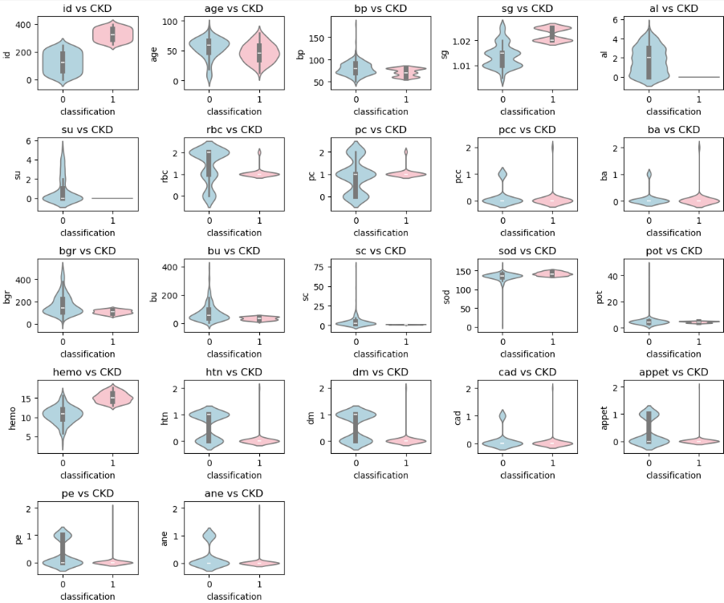
Feature Distribution by CKD Classification :

Slide 18
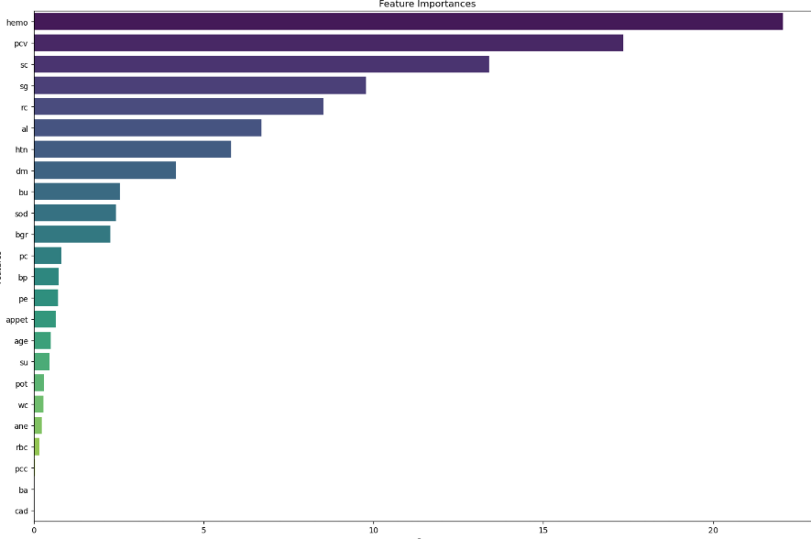
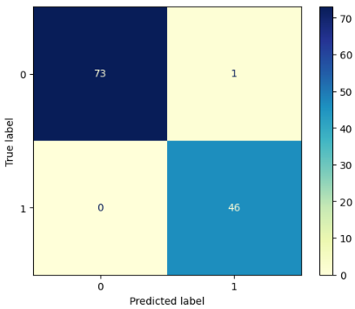
Feature importances:
Confusion Matrix :
CKD patients correctly predicted as CKD
Non-CKD pts correctly predicted as healthy
One healthy pt incorrectly predicted as CKD
NO CKD cases missed

Slide 19
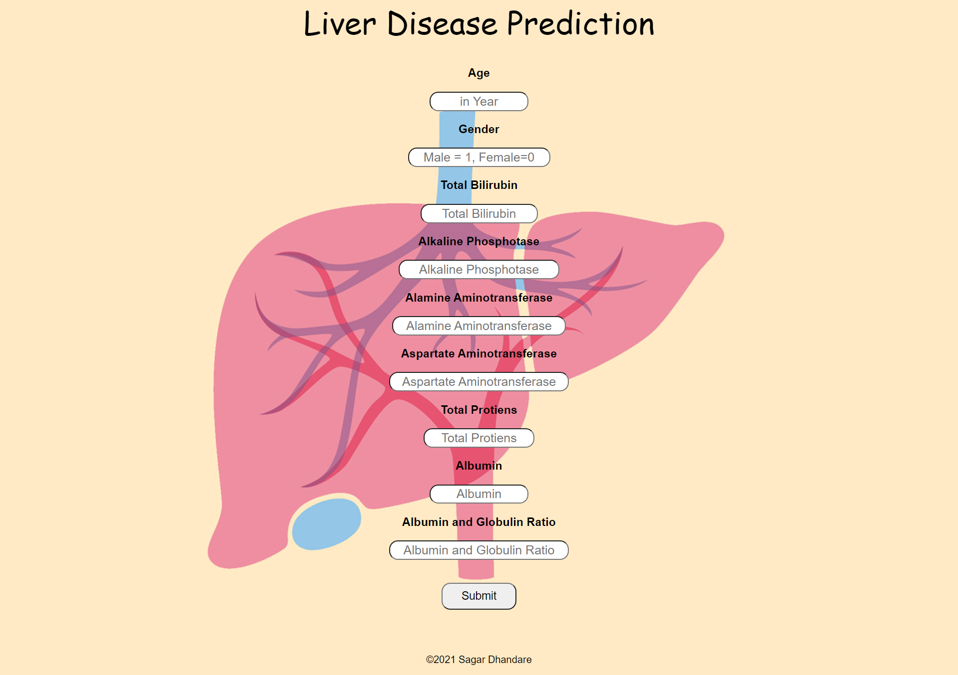
Liver disease prediction :

Slide 20
Load Data
Statistical analysis
Imputation
X = Features, y = Target
Train Test Split
Encoding
Normalization
Oversampling
Model Training :
Logistic Regression
Random Forest Classifier
KNN
XGBC

Slide 21
Logistic Regression
Accuracy = 73%
RFC
Accuracy = 73%
XGBC
Accuracy = 74%
Recall = 71%
F1 score = 72 %
AUC _ROC = 80%
Precision = 79%
Precision = 71%
Recall = 73%
F1 score = 72 %
AUC _ROC = 78%
Precision = 73%
Recall = 74%
F1 score = 73 %
AUC _ROC = 75%

Slide 22
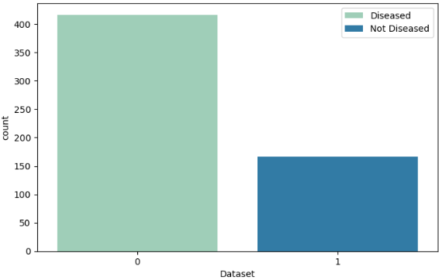
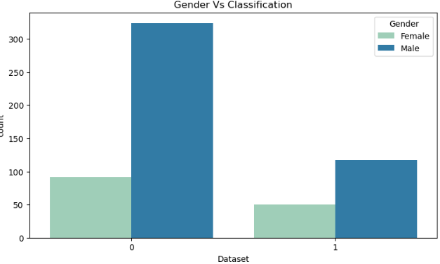
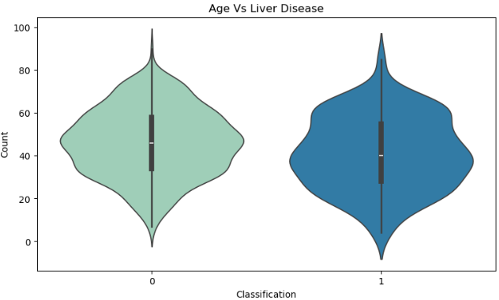
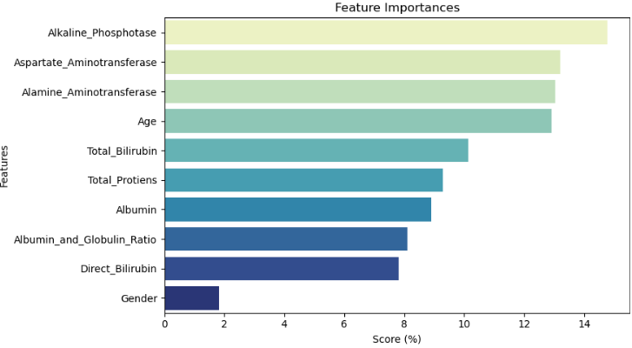

Slide 23
Results & Analysis :
Models achieved high prediction accuracy
XGBoost and Logistic performed better compared to other models
Results indicate effective disease prediction capability

Slide 24
User Interface (Streamlit) :
Interactive and user-friendly web interface
Separate sections for each disease prediction
Users input medical values easily
Prediction results displayed instantly

Slide 25
Advantages :
Enables early disease detection
Reduces dependency on manual diagnosis
Easy-to-use and interactive interface
Fast and efficient prediction system

Slide 26
Conclusion :
Machine Learning can effectively assist in disease prediction
The proposed system predicts Kidney, Liver, and Parkinson’s diseases accurately
Helps in early diagnosis and healthcare decision support
Future improvements can make the system more robust and scalable

Slide 27
THANK YOU

